Slide 1
CHE-HC-2024: PHYSICAL CHEMISTRY II
Chemical Thermodynamics
Class 5: Thermochemistry: Heats of reactions: standard states; enthalpy of formation of molecules and ions and enthalpy of combustion and its applications; calculation of bond energy, bond dissociation energy and resonance energy from thermochemical data, effect of temperature (Kirchhoff’s equations) and pressure on enthalpy of reactions. Adiabatic flame temperature, explosion temperature.
By
Dr. Dewan Shahidur Rahman

Slide 2
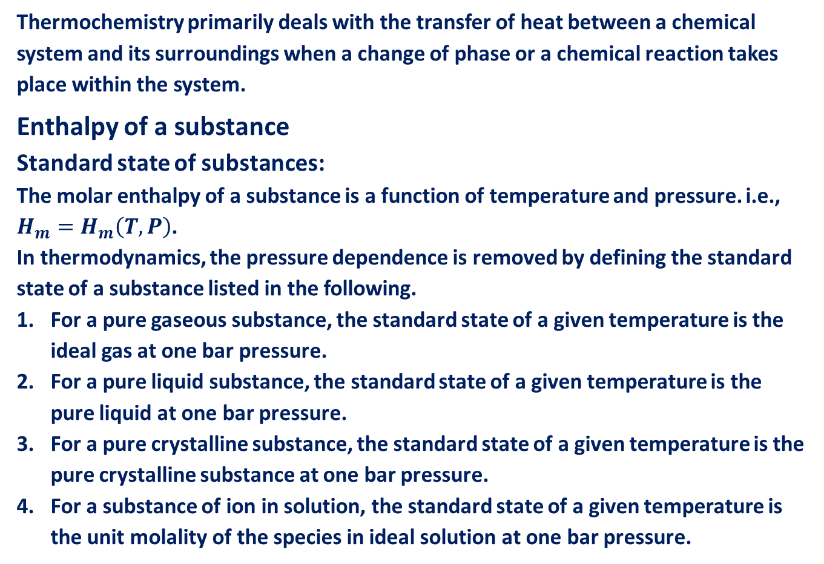
Thermochemistry
Thermochemistry primarily deals with the transfer of heat between a chemical system and its surroundings when a change of phase or a chemical reaction takes place within the system.
Enthalpy of a substance
Standard state of substances:
The molar enthalpy of a substance is a function of temperature and pressure. i.e., $H_{m}=H_{m}\left(T, P\right)$.
In thermodynamics, the pressure dependence is removed by defining the standard state of a substance listed in the following.
For a pure gaseous substance, the standard state of a given temperature is the ideal gas at one bar pressure.
For a pure liquid substance, the standard state of a given temperature is the pure liquid at one bar pressure.
For a pure crystalline substance, the standard state of a given temperature is the pure crystalline substance at one bar pressure.
For a substance of ion in solution, the standard state of a given temperature is the unit molality of the species in ideal solution at one bar pressure.

Slide 3
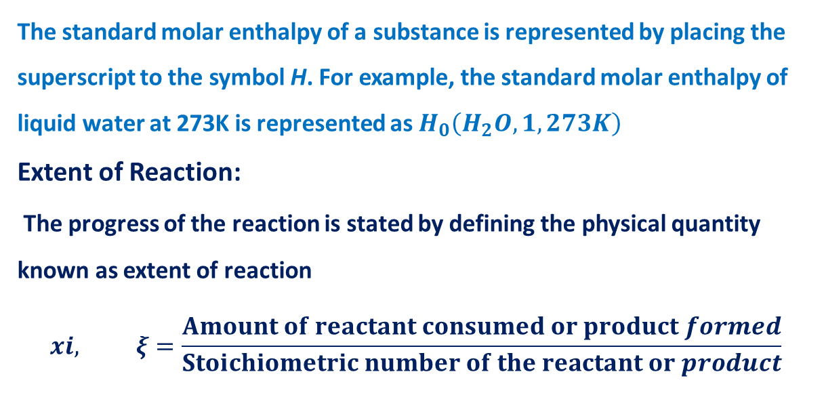
The standard molar enthalpy of a substance is represented by placing the superscript to the symbol H. For example, the standard molar enthalpy of liquid water at 273K is represented as $H_{0}\left(H_{2}O, 1, 273K\right)$
Extent of Reaction:
The progress of the reaction is stated by defining the physical quantity known as extent of reaction
$$xi, ξ=\frac{Amount of reactant consumed or product formed}{Stoichiometric number of the reactant or product}$$

Slide 4

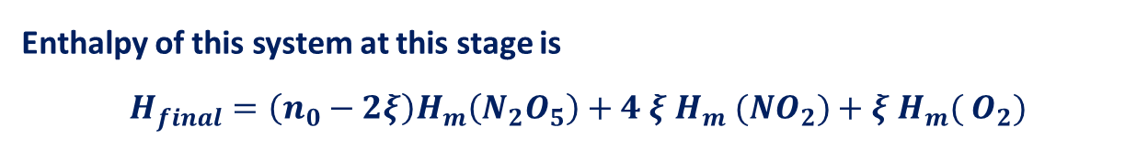
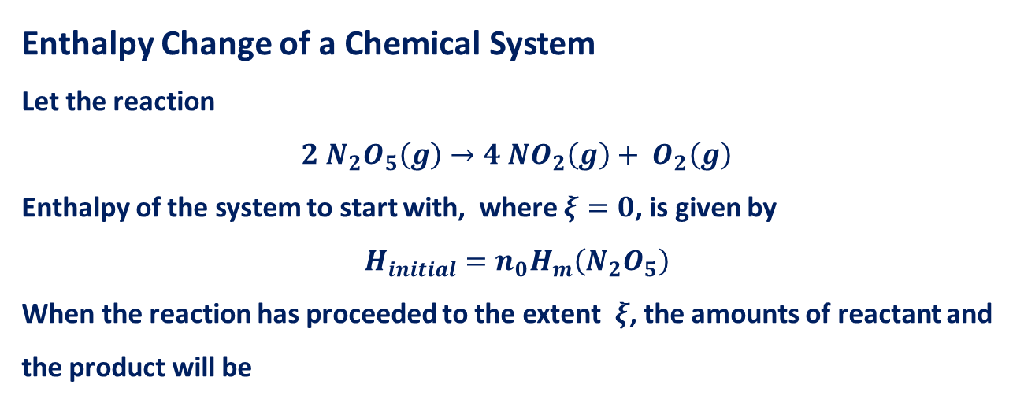



Enthalpy Change of a Chemical System
Let the reaction
$$2 N_{2}O_{5}\left(g\right)→4 NO_{2}\left(g\right)+ O_{2}\left(g\right)$$
Enthalpy of the system to start with, where $ξ=0$, is given by
$$H_{initial}=n_{0}H_{m}\left(N_{2}O_{5}\right)$$
When the reaction has proceeded to the extent $ξ$, the amounts of reactant and the product will be
$$2 N_{2}O_{5}\left(g\right)→4 NO_{2}\left(g\right)+ O_{2}\left(g\right)$$
$$n_{0}−2ξ$$
$$4ξ$$
$$ξ$$
Enthalpy of this system at this stage is
$$H_{final}=\left(n_{0}−2ξ\right)H_{m}\left(N_{2}O_{5}\right)+4 ξ H_{m} (NO_{2})+ξ{ H}_{m}( O_{2})$$

Slide 5




$$2 N_{2}O_{5}\left(g\right)→4 NO_{2}\left(g\right)+ O_{2}\left(g\right)$$
$$n_{0}−2ξ$$
$$4ξ$$
$$ξ$$

Slide 6
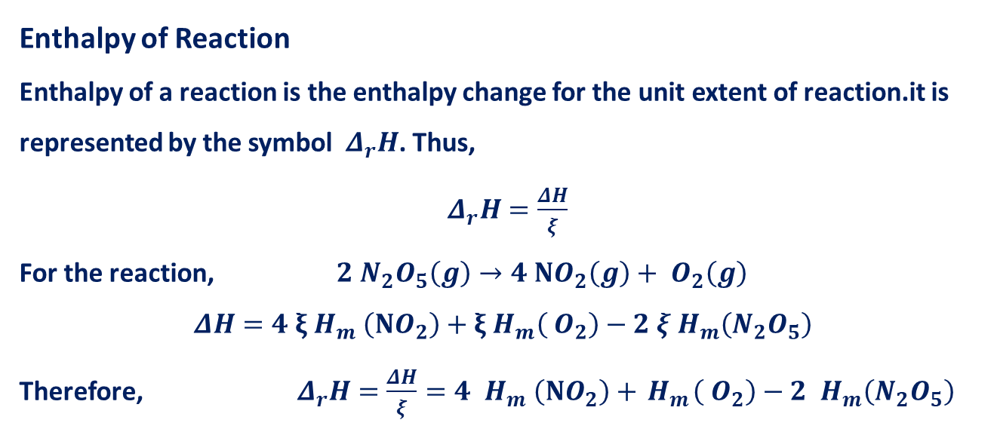
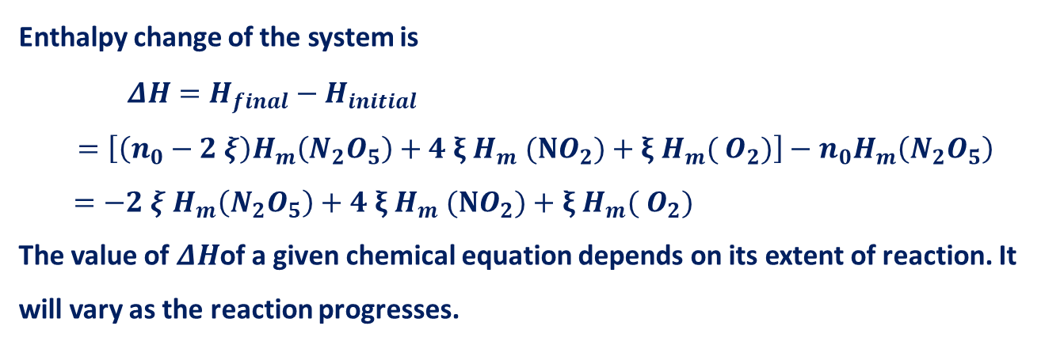
Enthalpy change of the system is
$ΔH=H_{final}−H_{initial}$
$$=\left[\left(n_{0}−2 ξ\right)H_{m}\left(N_{2}O_{5}\right)+4 ξ H_{m} (NO_{2})+ξ{ H}_{m}( O_{2})\right]−n_{0}H_{m}\left(N_{2}O_{5}\right)$$
$=−2 ξ{ H}_{m}\left(N_{2}O_{5}\right)+4 ξ{ H}_{m} (NO_{2})+ξ{ H}_{m}( O_{2})$
The value of $ΔH$of a given chemical equation depends on its extent of reaction. It will vary as the reaction progresses.
Enthalpy of Reaction
Enthalpy of a reaction is the enthalpy change for the unit extent of reaction.it is represented by the symbol $Δ_{r}H$. Thus,
$Δ_{r}H=\frac{ΔH}{ξ}$
For the reaction, $2 N_{2}O_{5}\left(g\right)→4 NO_{2}\left(g\right)+ O_{2}\left(g\right)$
$$ΔH=4 ξ{ H}_{m} \left(NO_{2}\right)+ξ{ H}_{m}\left( O_{2}\right)−2 ξ{ H}_{m}\left(N_{2}O_{5}\right)$$
Therefore, $Δ_{r}H=\frac{ΔH}{ξ}=4 { H}_{m} \left(NO_{2}\right)+{ H}_{m}\left( O_{2}\right)−2 { H}_{m}\left(N_{2}O_{5}\right)$
$$2 N_{2}O_{5}\left(g\right)→4 NO_{2}\left(g\right)+ O_{2}\left(g\right)$$
$$n_{0}−2ξ$$
$$4ξ$$
$$ξ$$

Slide 7
Thank You

