Slide 1
CHE-HC-2024: PHYSICAL CHEMISTRY II
Chemical Thermodynamics
Class 2: State and path functions; zeroth law of thermodynamics, Heat and Work, First law of thermodynamics
By
Dr. Dewan Shahidur Rahman

Slide 2
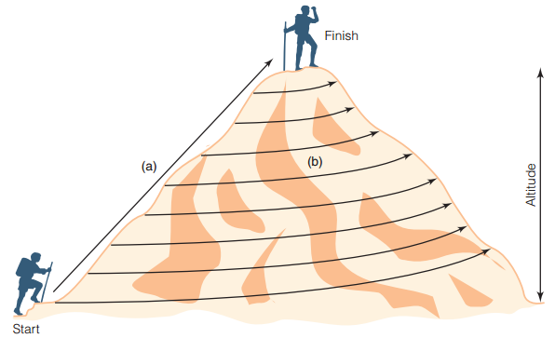
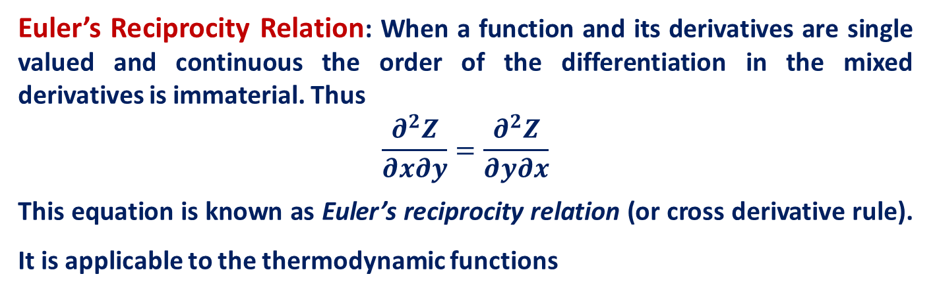
Euler’s Reciprocity Relation: When a function and its derivatives are single valued and continuous the order of the differentiation in the mixed derivatives is immaterial. Thus
$$\frac{∂^{2}Z}{∂x∂y}=\frac{∂^{2}Z}{∂y∂x}$$
This equation is known as Euler’s reciprocity relation (or cross derivative rule). It is applicable to the thermodynamic functions
Path Variables
The variables or functions which do not depends on the initial and final state of a system but depends on the path of a process is called path function. e.g., distance , heat, work etc.

Slide 3
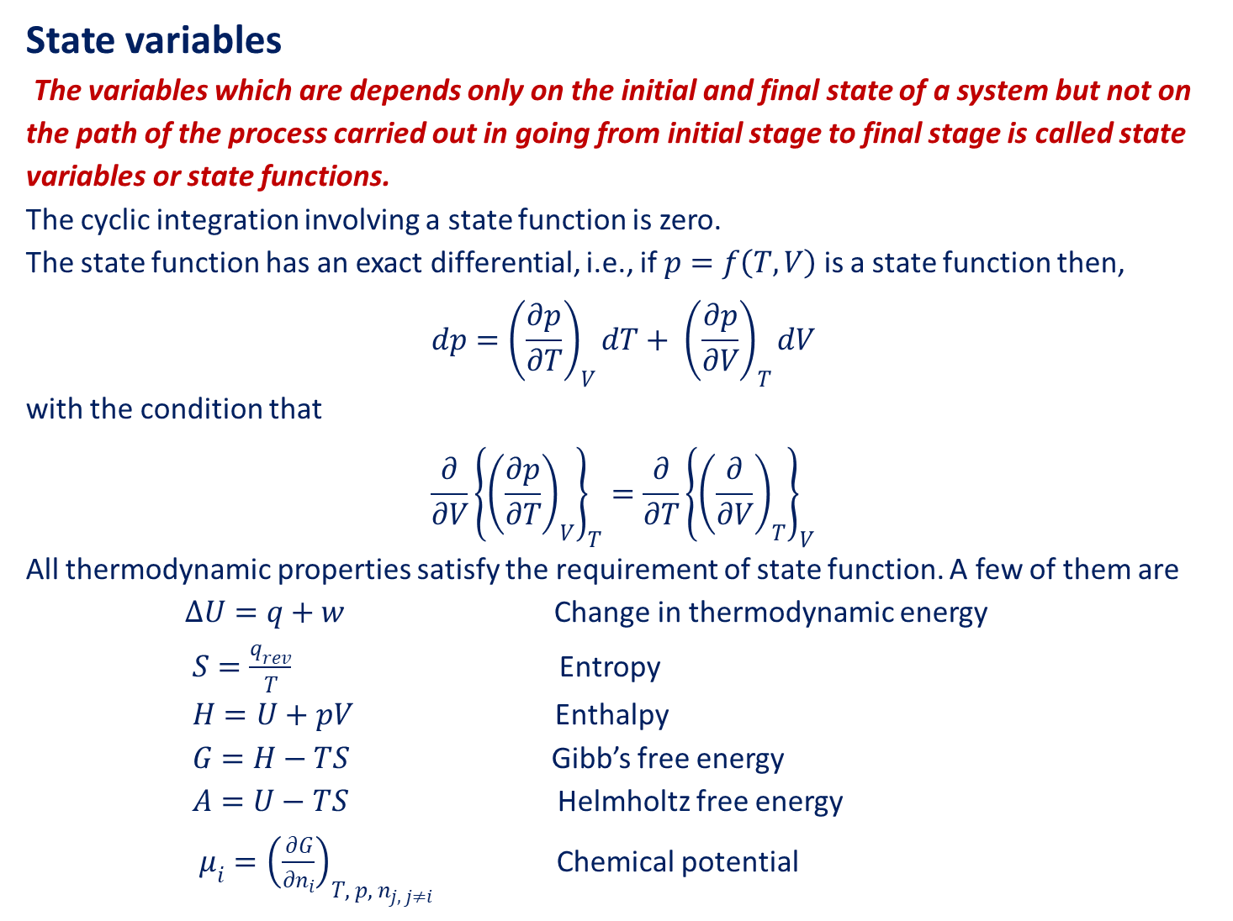
State variables
The variables which are depends only on the initial and final state of a system but not on the path of the process carried out in going from initial stage to final stage is called state variables or state functions.
The cyclic integration involving a state function is zero.
The state function has an exact differential, i.e., if $p=f\left(T,V\right)$ is a state function then,
$$dp={\left(\frac{∂p}{∂T}\right)}_{V}dT+ {\left(\frac{∂p}{∂V}\right)}_{T}dV$$
with the condition that
$$\frac{∂}{∂V}{\left\{{\left(\frac{∂p}{∂T}\right)}_{V}\right\}}_{T}=\frac{∂}{∂T}{\left\{{\left(\frac{∂}{∂V}\right)}_{T}\right\}}_{V}$$
All thermodynamic properties satisfy the requirement of state function. A few of them are
$∆U=q+w$ Change in thermodynamic energy
$S=\frac{q_{rev}}{T}$ Entropy
$H=U+pV$ Enthalpy
$G=H−TS$ Gibb’s free energy
$A=U−TS$ Helmholtz free energy
$μ_{i}={\left(\frac{∂G}{∂n_{i}}\right)}_{T, p, n_{j, j≠i}}$ Chemical potential

Slide 4
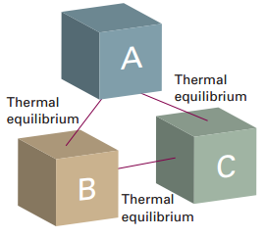
Zeroth Law of Thermodynamics
The zeroth law of thermodynamic also known as law of thermal equilibrium. This law states that “Two systems in thermal equilibrium with a third system are also in thermal equilibrium with each other”.
According to this law, if system A and B separately are in thermal equilibrium with another system C, then system A and B will also be in thermal equilibrium with each other.

Slide 5
IUPAC Convention of Work and Heat
According to IUPAC convention, heat absorbed by the system is regarded as positive quantity whereas; heat release by the system is regarded as the negative quantity. Conversely, if the numerical value of heat is positive, heat is absorbed by the system and if the numerical value is negative, heat is release from the system.
For work, the IUPAC convention is to take the work done on the system as the positive quantity whereas; the work done by the system is taken as negative quantity. Conversely speaking, if the numerical of work is positive, it implies that the work is done on the system and if it carries a negative sign, it implies that work is done by the system.
Work involved in expansion and compression processes
If the volume of the system is increased against some pressure, then work is done by the system on the surrounding and is, by convention, given a negative sign. On the other hand, if the volume of the system is decreased, the work is done by the surrounding on the system and is given a positive sign.

Slide 6
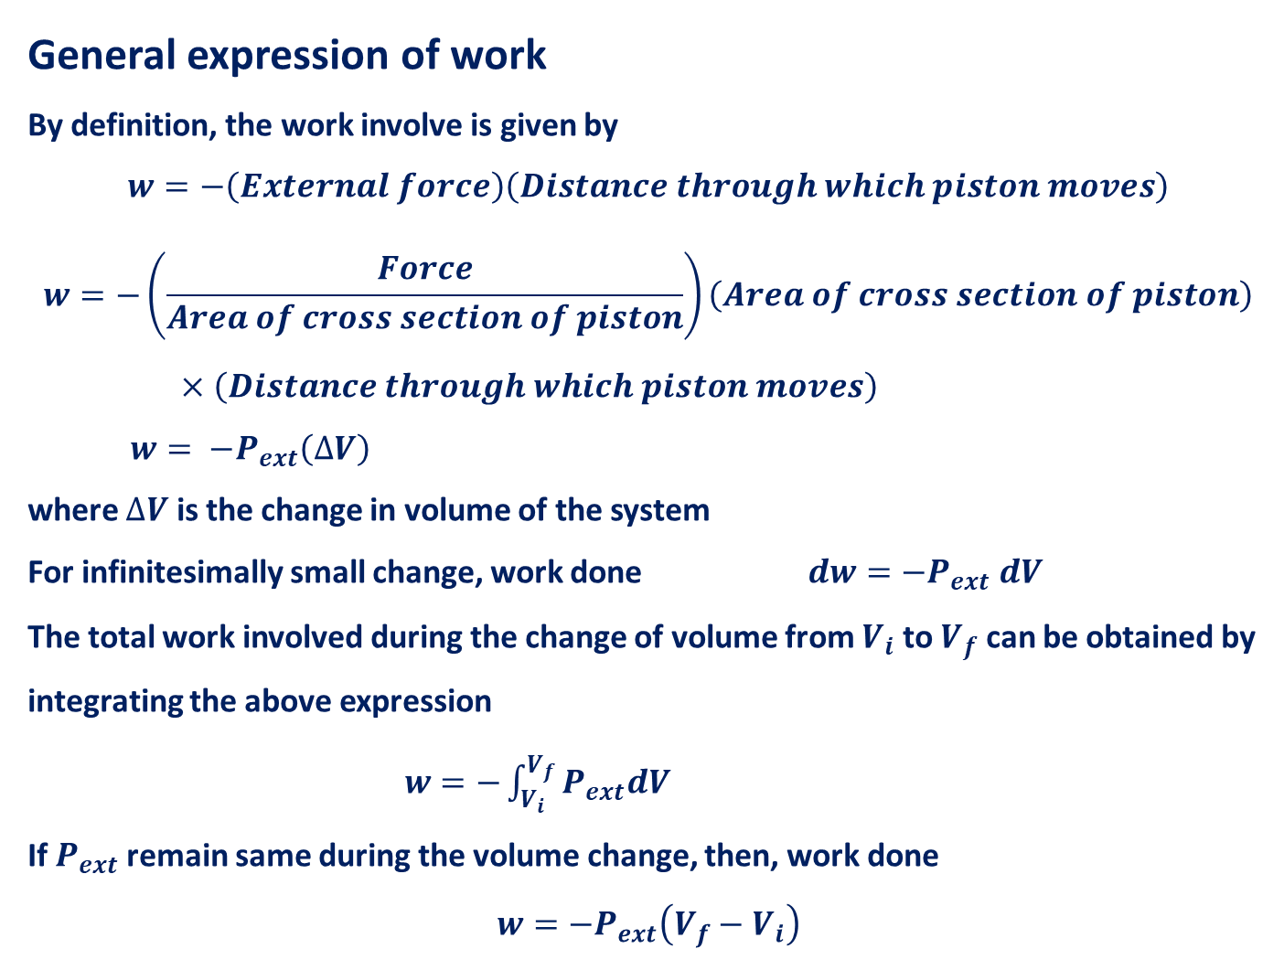
General expression of work
By definition, the work involve is given by
$$w=−\left(External force\right)\left(Distance through which piston moves\right)$$
$$w=−\left(\frac{Force}{Area of cross section of piston}\right)\left(Area of cross section of piston\right)×\left(Distance through which piston moves\right)$$
$w= −P_{ext}\left(∆V\right)$
where $∆V$ is the change in volume of the system
For infinitesimally small change, work done $dw={−P}_{ext} dV$
The total work involved during the change of volume from $V_{i}$ to $V_{f}$ can be obtained by integrating the above expression
$w=−\int_{V_{i}}^{V_{f}}{P_{ext}dV}$
If $P_{ext}$remain same during the volume change, then, work done
$$w=−P_{ext}\left(V_{f}−V_{i}\right)$$

Slide 7
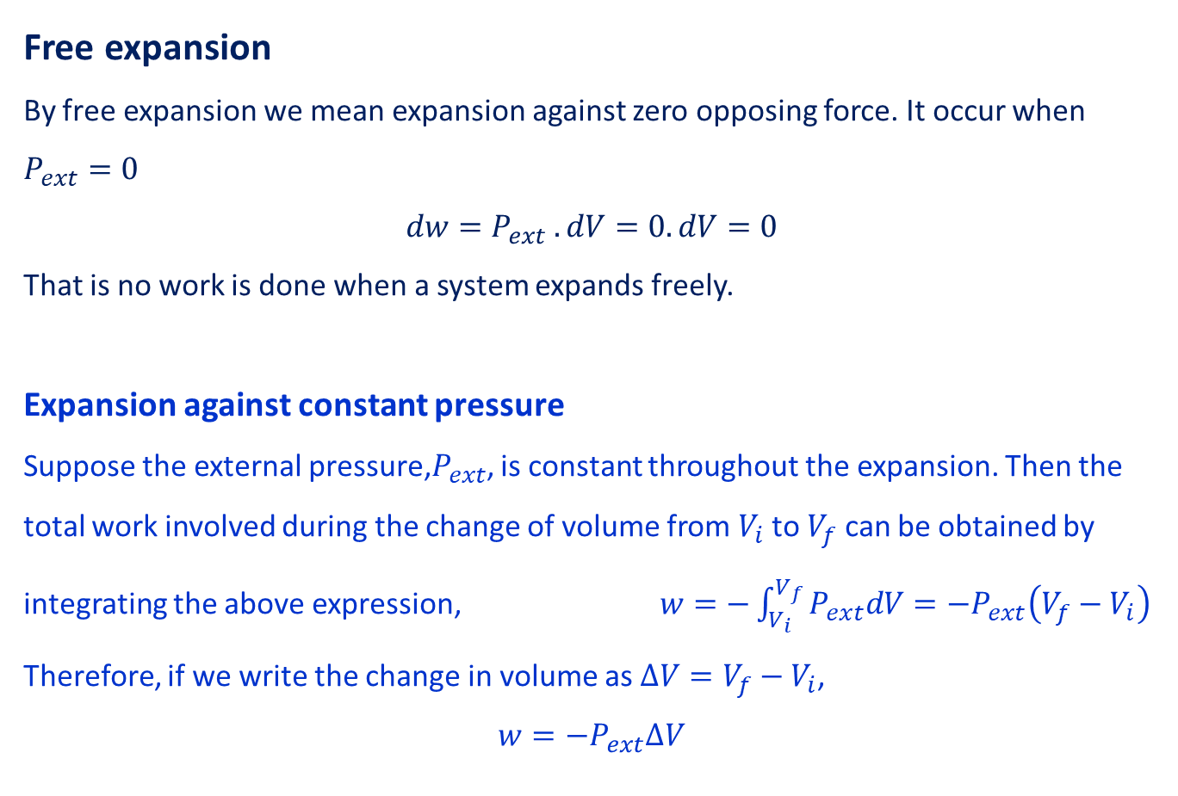
Free expansion
By free expansion we mean expansion against zero opposing force. It occur when $P_{ext}=0$
$$dw=P_{ext} .dV=0.dV=0$$
That is no work is done when a system expands freely.
Expansion against constant pressure
Suppose the external pressure,$P_{ext}$, is constant throughout the expansion. Then the total work involved during the change of volume from $V_{i}$ to $V_{f}$ can be obtained by integrating the above expression, $w=−\int_{V_{i}}^{V_{f}}{P_{ext}dV}=−P_{ext}\left(V_{f}−V_{i}\right)$
Therefore, if we write the change in volume as $∆V=V_{f}−V_{i}$,
$$w=−P_{ext}∆V$$

Slide 8
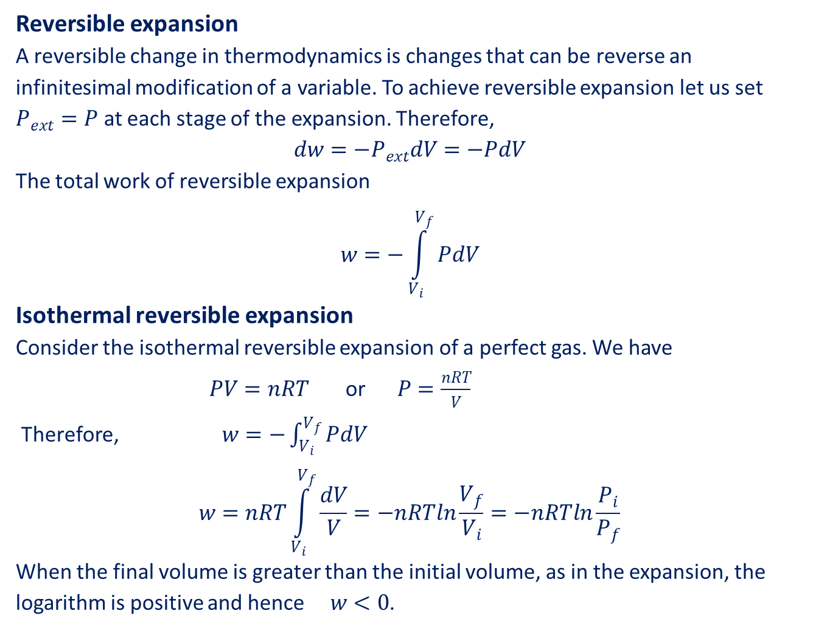
Reversible expansion
A reversible change in thermodynamics is changes that can be reverse an infinitesimal modification of a variable. To achieve reversible expansion let us set $P_{ext}=P$ at each stage of the expansion. Therefore,
$$dw=−P_{ext}dV=−PdV$$
The total work of reversible expansion
$$w=−\int_{V_{i}}^{V_{f}}{PdV}$$
Isothermal reversible expansion
Consider the isothermal reversible expansion of a perfect gas. We have
$PV=nRT$ or $P=\frac{nRT}{V}$
Therefore, $w=−\int_{V_{i}}^{V_{f}}{PdV}$
$$w=nRT\int_{V_{i}}^{V_{f}}{\frac{dV}{V}=−nRTln\frac{V_{f}}{V_{i}}}=−nRTln\frac{P_{i}}{P_{f}}$$
When the final volume is greater than the initial volume, as in the expansion, the logarithm is positive and hence $w<0$.

Slide 9
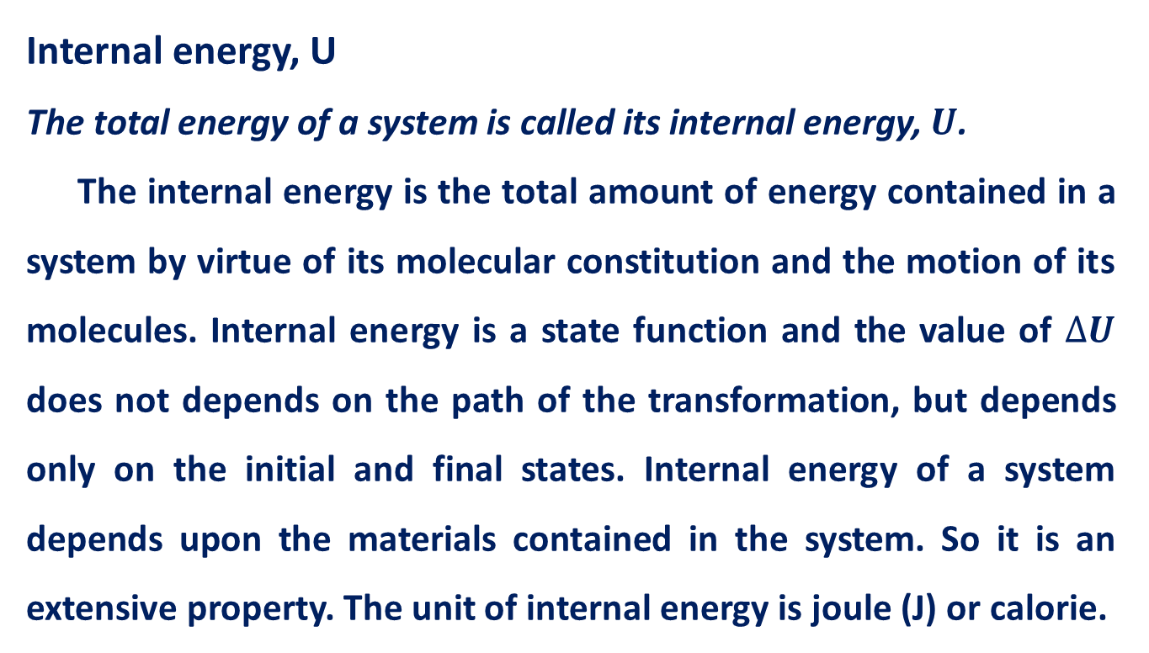
Internal energy, U
The total energy of a system is called its internal energy, $U$.
The internal energy is the total amount of energy contained in a system by virtue of its molecular constitution and the motion of its molecules. Internal energy is a state function and the value of $∆U$ does not depends on the path of the transformation, but depends only on the initial and final states. Internal energy of a system depends upon the materials contained in the system. So it is an extensive property. The unit of internal energy is joule (J) or calorie.

Slide 10
First Law of Thermodynamics
The first law of thermodynamics is essentially the law of conservation of energy. This law introduces the concept of internal energy and may be stated in the following different ways.
Energy can neither be created nor destroyed
The total energy of the universe is conserved.
The total internal energy of an isolated system remains constant.
Whenever a quantity of one kind of energy disappears, an exactly equivalent quantity of energy in some other form must appear.
This law states that if at any time there is a decrease in internal energy in any portion of the universe, there must be a simultaneous, corresponding increase in the internal energy of the rest of the universe.

Slide 11
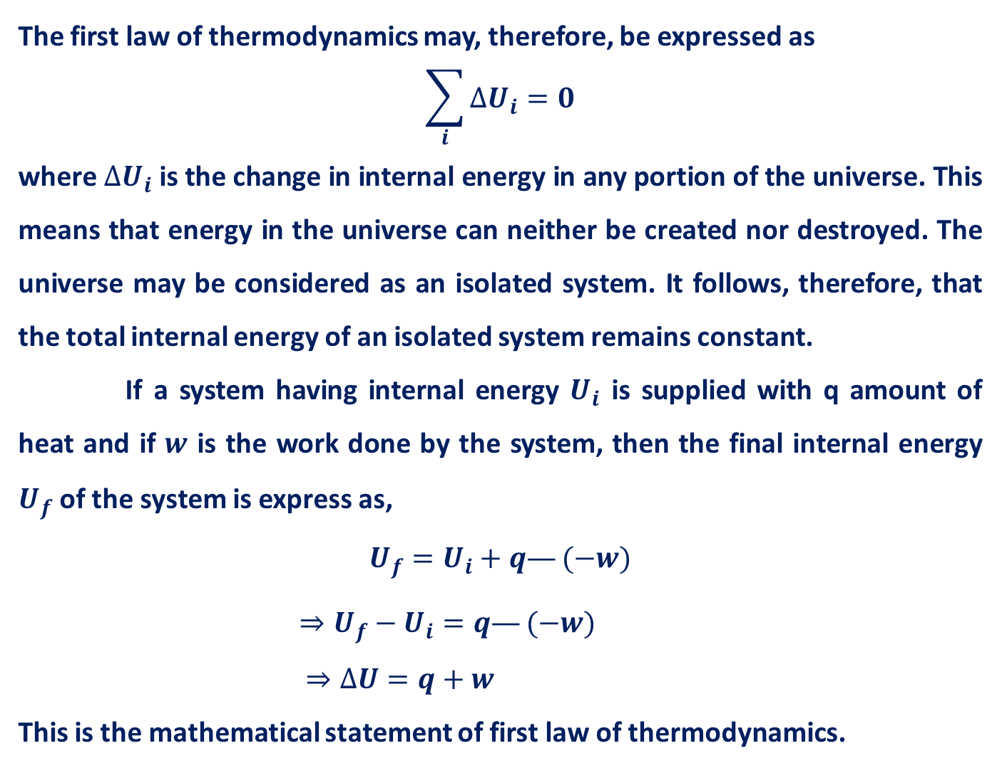
The first law of thermodynamics may, therefore, be expressed as
$$\sum_{i}{∆U_{i}=0}$$
where $∆U_{i}$ is the change in internal energy in any portion of the universe. This means that energy in the universe can neither be created nor destroyed. The universe may be considered as an isolated system. It follows, therefore, that the total internal energy of an isolated system remains constant.
If a system having internal energy $U_{i}$ is supplied with q amount of heat and if $w$ is the work done by the system, then the final internal energy $U_{f}$ of the system is express as,
$$U_{f}=U_{i}+q—(−w)$$
$⇒U_{f}−U_{i}=q—(−w)$
$⇒∆U=q+w$
This is the mathematical statement of first law of thermodynamics.

Slide 12
Thank You

