Slide 1
Lecture on Fundamental Right
Prof. Jalal Uddin Ahmed
Associate Professor & HOD,
Department of Political Science
West Goalpara College

Slide 2
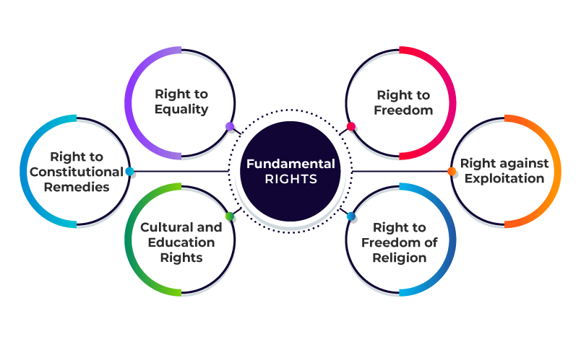
Kinds of Fundamental Rights

Slide 3
Right to Equality

Slide 4
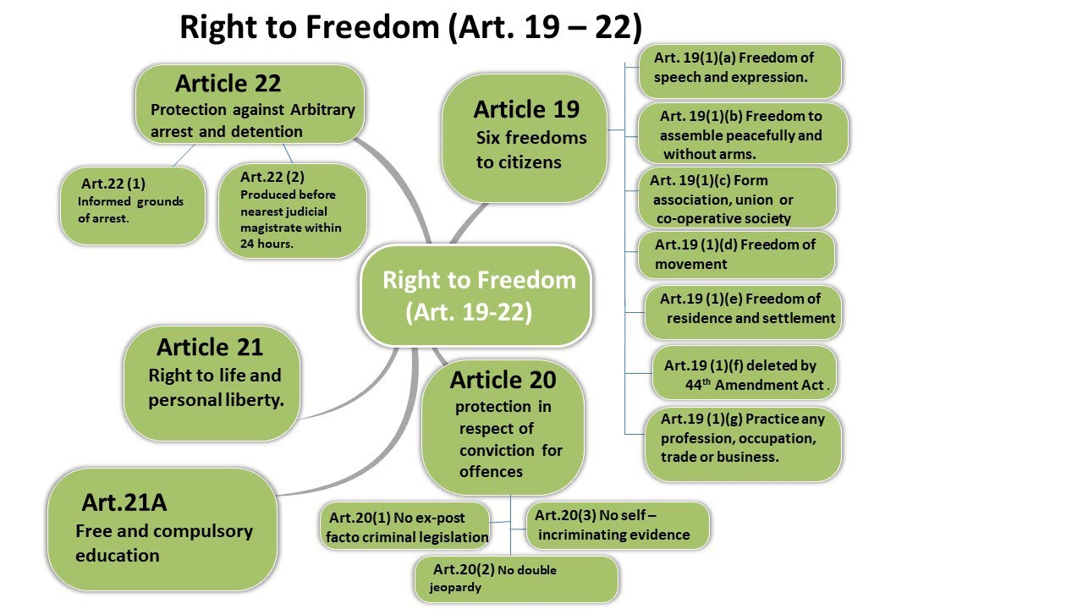
Right to Liberty

Slide 5
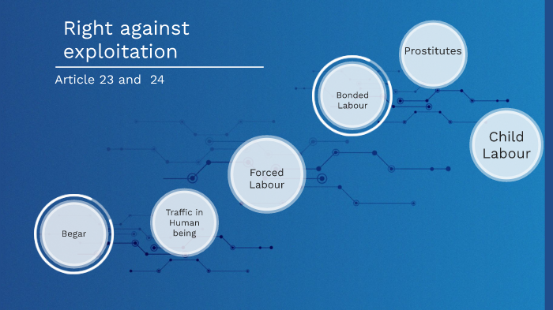
Right Against Exploitation

Slide 6
Right to Freedom of Religion

Slide 7
Cultural and Educational Rights

Slide 8
Right to Constitutional Remedies

